Slide 1


Notes:
Hi everyone, my name is Sarah Araujo.
Today I’ll present my final project, Brazil Extreme Rainfall Intensity Forecaster – B-ERIF.
I’ll show how I used machine learning to model extreme rainfall in Rio Grande do Sul and to explore whether we can recalibrate IDF curves with ML

Slide 2
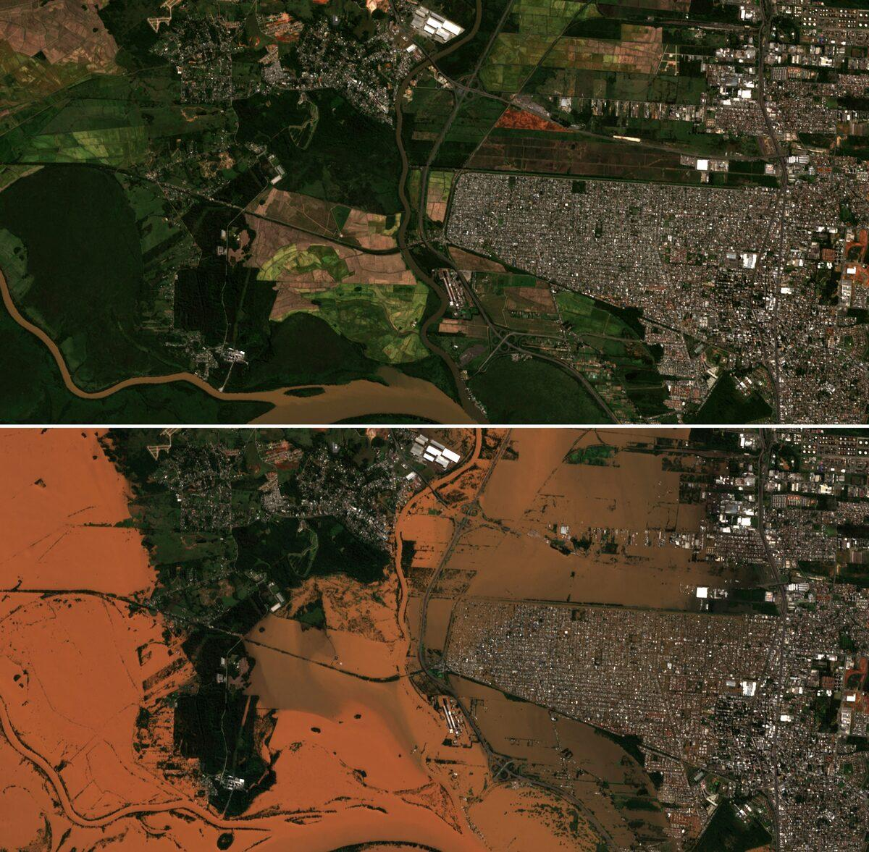
Why this Project?
2024 floods in Rio Grande do Sul (RS), Brazil
Urban drainage design still relies on static IDF curves
Possible climate non-stationarity → traditional IDFs may be outdated
Question: Can ML help us understand and recalibrate rainfall extremes?
1| Brazil Extreme Rainfall Intensity Forecaster
Notes:
The motivation comes from the 2024 floods in Rio Grande do Sul, which caused severe damage and exposed how vulnerable cities are to prolonged heavy rainfall.
Urban drainage design still relies on static IDF curves, often based on older data and stationarity assumptions.
So my guiding question was: Can machine learning help us better understand, and potentially recalibrate, rainfall extremes in this region?

Slide 3
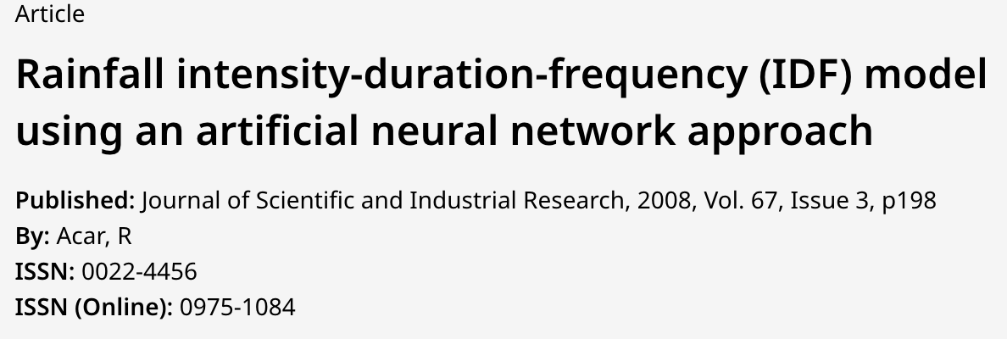
Research
“Previous work has already used artificial neural networks as surrogates for IDF curves, learning the mapping from rainfall data to intensity–duration–frequency relationships. This suggests that ML can be used not only to fit extremes, but potentially to recalibrate them under new conditions (climate change, new data sets, etc.).”
2| Brazil Extreme Rainfall Intensity Forecaster
Notes:
Previous work has already used artificial neural networks as surrogates for IDF curves, learning the mapping directly from rainfall data to intensity–duration–frequency relationships.
This suggests that machine learning can be used not only to fit extremes with traditional distributions, but potentially to recalibrate IDF curves under new conditions, like climate change or when new data sets become available.
My project builds on this idea, but focuses specifically on Rio Grande do Sul and on recent extreme events, such as the 2024 floods.

Slide 4
Project Objectives
Use ML models to forecast daily rainfall extremes in RS
Train a VAE to generate synthetic annual maxima
Build ML-based IDF curves and compare with observed IDFs
Evaluate if ML can support IDF recalibration under recent extremes
3 | Brazil Extreme Rainfall Intensity Forecaster
Notes:
From this question, I defined four main objectives.
First, use ML models to forecast daily rainfall extremes in RS.
Second, train a VAE to generate synthetic annual maxima.
Third, derive ML-based IDF curves and compare them with observed curves.
And finally, assess how far ML can go towards reliable IDF recalibration in this setting.

Slide 5
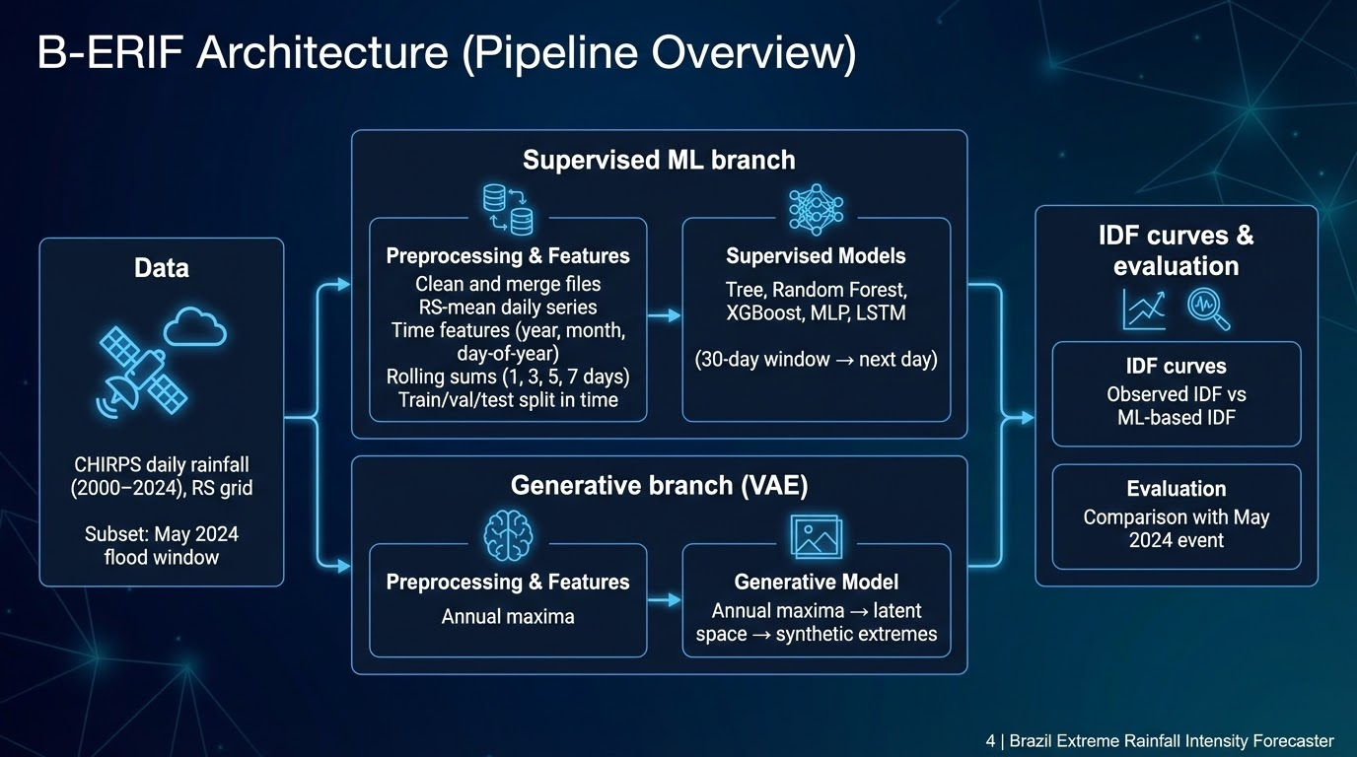
Notes:
This slide summarizes the B-ERIF pipeline.
I start with CHIRPS daily rainfall from 2000 to 2024 over RS, including the May 2024 flood window.
Then I preprocess and build features: RS-mean series, annual maxima, time features and rolling rainfall sums, and I split the data in time.
From there, the pipeline branches into supervised models – tree-based models, MLP and LSTM – and a VAE for annual maxima.
Finally, I use these outputs to build ML-based IDF curves and compare them with observed IDF and the 2024 flood event.

Slide 6
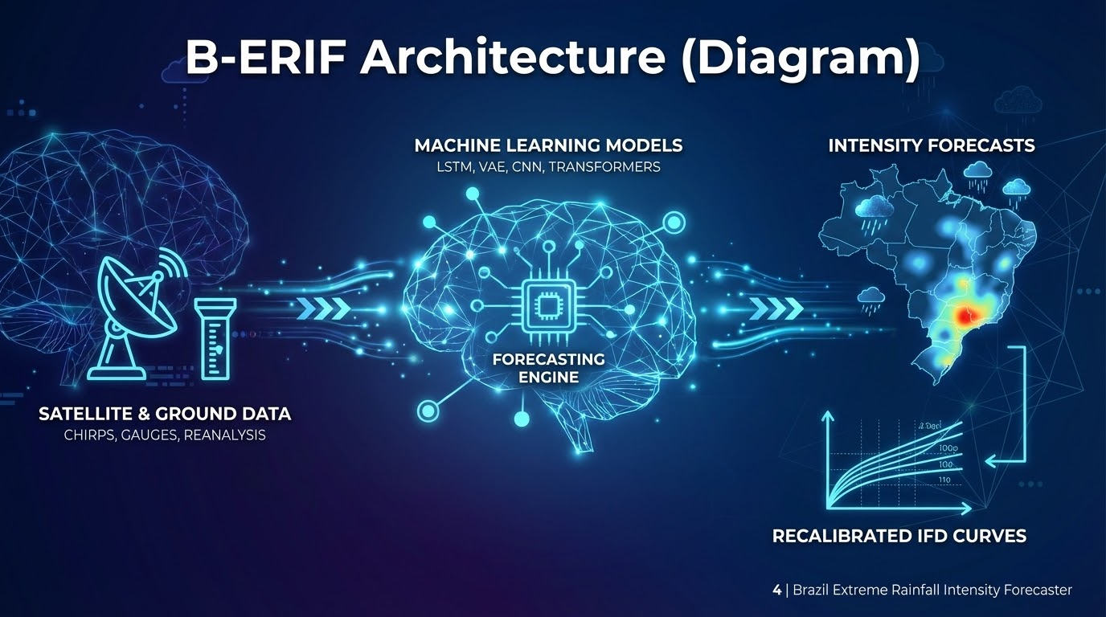

Slide 7
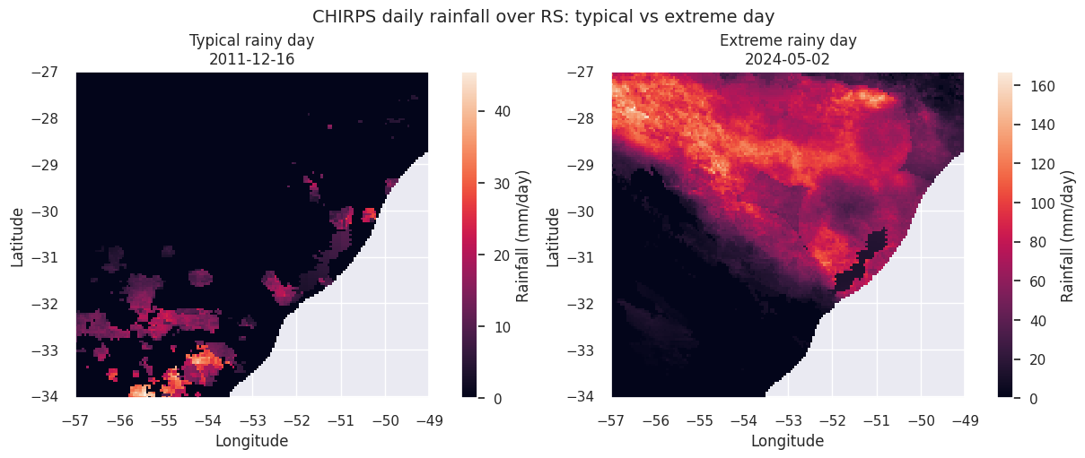
CHIRPS rainfall over Rio Grande do Sul
Data
CHIRPS daily rainfall (2000–2024)
Spatial domain: RS grid
RS-mean daily time series used for LSTM
6 | Brazil Extreme Rainfall Intensity Forecaster
Notes:
On the left you see a typical rainy day, where rainfall is patchy and mostly below 40 millimeters per day.
On the right you see an extreme rainy day, May 2nd, 2024, when large areas of the state recorded more than 100–150 millimeters in a single day, contributing to the recent floods.
From this gridded product I also compute an RS-mean daily time series, which is what I later use to train the LSTM model.

Slide 8
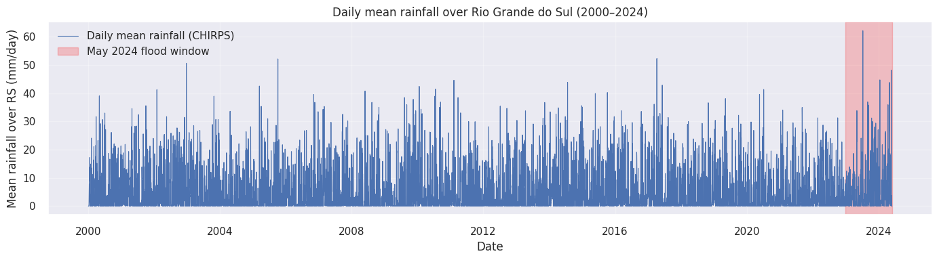
Feature engineering & time split
Preprocessing
Highly skewed distribution
Many dry/low-rain days, few extremes
Difficult target for ML; motivates:
focus on extreme tails
sampling strategies for training
6 | Brazil Extreme Rainfall Intensity Forecaster
Notes:
This histogram shows the distribution of daily rainfall.
It’s highly skewed: many days with almost no rain, and relatively few high-rainfall events.
For ML, this means models tend to learn the ‘easy’ part of the distribution and struggle with the tail, which is exactly where extremes live.
That motivates both the focus on annual maxima and some sampling choices in the training set.

Slide 9
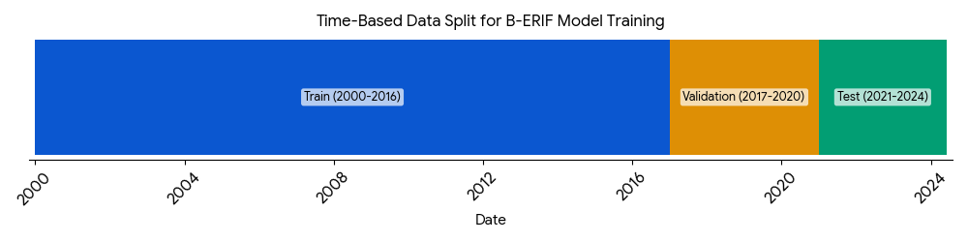
Feature engineering & time split
Features
Features:
Time: year, month, day-of-year
Spatial: x, y (when grid-based)
Rolling rainfall: 1, 3, 5, 7-day sums
Time-based split:
Train: 2000–2016
Validation: 2017–2020
Test: 2021–2024
Avoids information leakage from future to past
7 | Brazil Extreme Rainfall Intensity Forecaster
Notes:
For the supervised models, I use simple but meaningful features: year, month, day-of-year, spatial coordinates when working with the grid, and rolling rainfall sums over 1, 3, 5 and 7 days to capture persistence.
I apply a purely time-based split: training from 2000–2016, validation 2017–2020, and test 2021–2024.
This avoids leakage from the future and makes the evaluation more realistic for forecasting and IDF analysis

Slide 10
Models explored
Models
Supervised models (daily forecasting):
Decision Tree (baseline)
Random Forest (RandomizedSearchCV)
XGBoost (RandomizedSearchCV)
MLPRegressor
LSTM_point (30-day RS-mean window → next day)
Generative model (extremes):
Variational Autoencoder (VAE) on annual maxima
8 | Brazil Extreme Rainfall Intensity Forecaster
Notes:
On the model side, I test several regression models: a Decision Tree as a baseline, Random Forest, XGBoost, a shallow MLPRegressor, and an LSTM that takes 30 days of RS-mean rainfall and predicts the next day.
For extremes, I train a Variational Autoencoder on the series of annual maximum daily rainfall, and use it to generate synthetic maxima.
Because of RAM limits, all hyperparameter searches are intentionally small and done with RandomizedSearchCV.

Slide 11
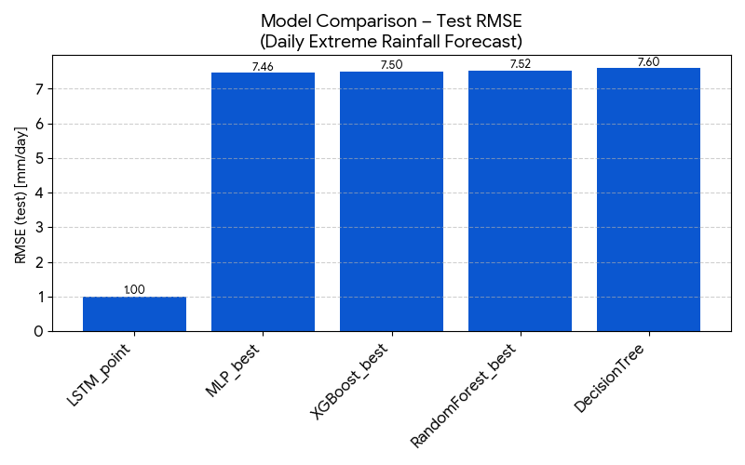
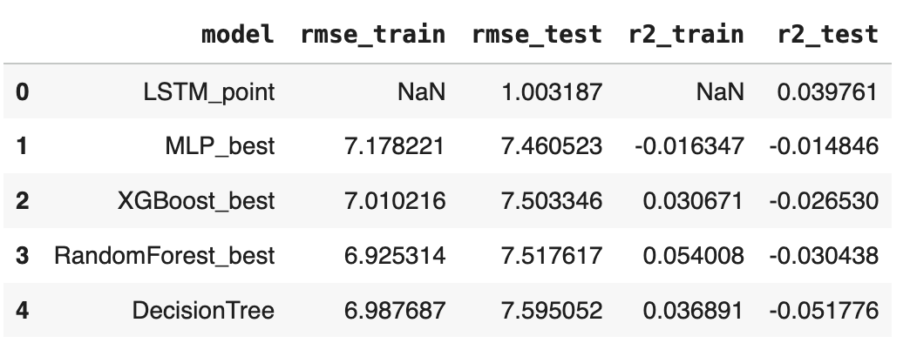
Model comparison (test RMSE / R²)
Evaluation
LSTM shows lower test RMSE on the RS-mean series
Tree / RF / XGB / MLP are all in a similar RMSE and R² range
Overall R² close to zero on the full grid → ML learns mainly climatology, not event-to-event extremes
9 | Brazil Extreme Rainfall Intensity Forecaster
Notes:
This bar plot compares the test RMSE and R² across models.
The tree-based models and the MLP all end up with similar RMSEs, around 7.5 mm/day, and R² close to zero, meaning they mostly reproduce the same average.
The LSTM_point, evaluated on the RS-mean series, has a much lower RMSE, around 1 mm/day when converted back to mm.
So, in terms of overall daily skill, LSTM clearly helps – but this doesn’t automatically mean it fixes the extreme tail, which we’ll see next

Slide 12
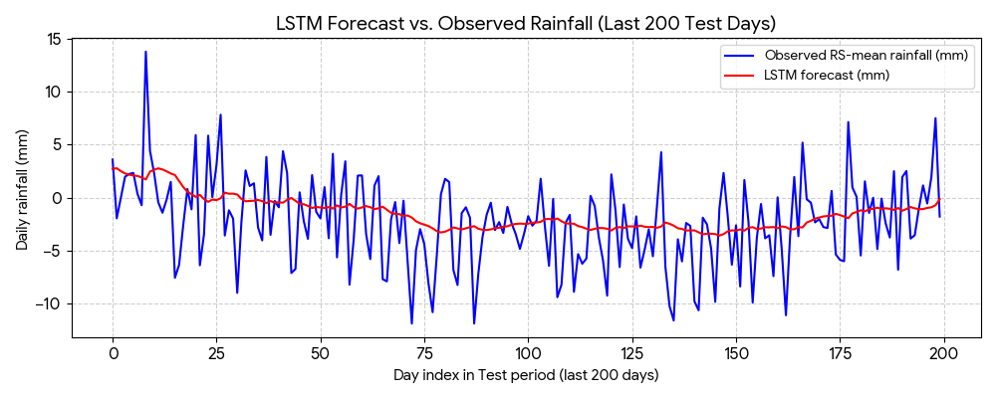
LSTM – test time series (RS-mean)
Evaluation
LSTM captures timing and magnitude of typical rainy periods
Good at average behaviour
Still underestimates most extreme peaks
10 | Brazil Extreme Rainfall Intensity Forecaster
Notes:
This plot shows the last part of the test period for the LSTM.
The blue line is the observed RS-mean rainfall, the orange line is the LSTM forecast.
The LSTM does a good job capturing when wet periods happen and approximate magnitudes for typical events.
But the highest peaks are consistently smoothed and underestimated, which is a key limitation when we think about extreme design values

Slide 13
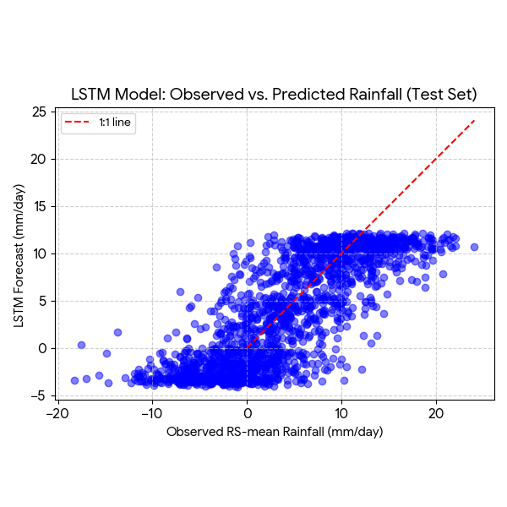
LSTM: observed vs predicted scatter
Evaluation
Near-diagonal for low to moderate rainfall
Systematic underestimation for high rainfall
Explains why ML-based IDF curves still sit below the most extreme observations
11 | Brazil Extreme Rainfall Intensity Forecaster
Notes:
The scatter plot makes this bias even clearer.
On the x-axis we have observed rainfall and on the y-axis the LSTM prediction, with a 1:1 reference line.
For low to moderate values, points are close to the diagonal.
For higher values, points tend to fall below the line, indicating systematic underestimation of the largest events.
This behaviour carries over into the IDF curves

Slide 14
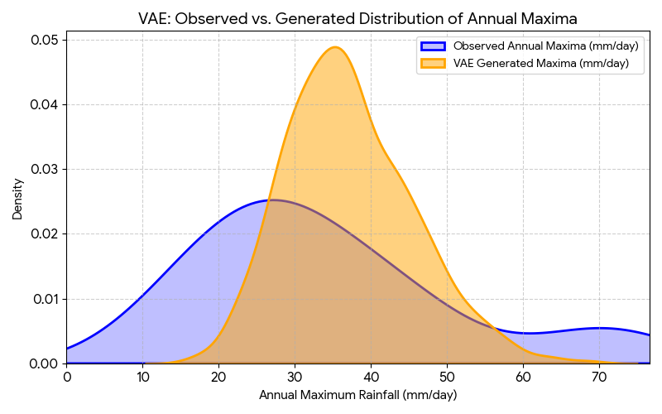
VAE: annual maxima
VAE
VAE trained on annual maximum daily rainfall
Learns a latent space of extremes
Generated maxima have:
- Similar overall shape
- But less heavy tails than observed
12 | Brazil Extreme Rainfall Intensity Forecaster
Notes:
Here I compare the observed distribution of annual maxima with the distribution of maxima generated by the VAE.
The VAE captures the overall shape and typical range of annual maxima, which means the latent space is meaningful.
But again, the tail of the generated distribution is lighter than the observed one – the most extreme values are underrepresented.
So both models – LSTM and VAE – are useful, but they still miss the very upper tail, which matters most for IDF

Slide 15
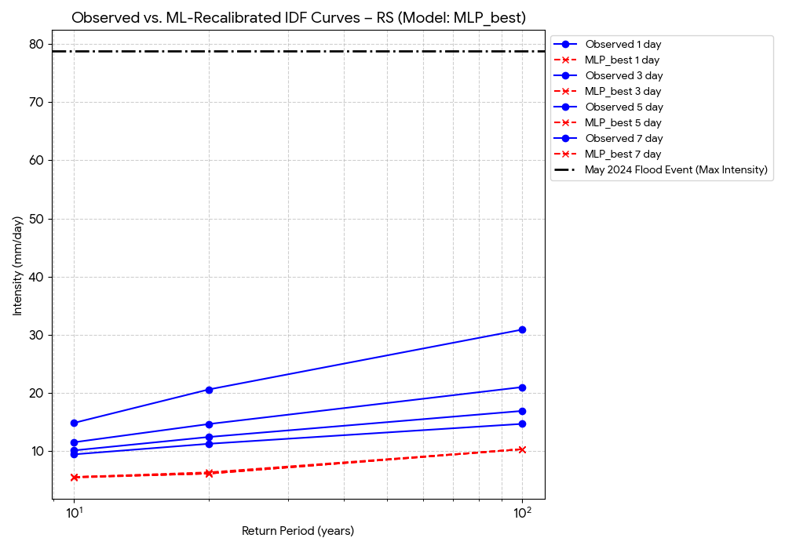
IDF curves: Observed vs ML-based IDF curves (1–7 days)
IDF
Observed IDF curves from CHIRPS (2000–2024)
ML-based IDF curves:
derived from LSTM and/or VAE maxima
May 2024 flood:
lies above both observed and ML-based curves
13 | Brazil Extreme Rainfall Intensity Forecaster
Notes:
This is the core result from the IDF perspective.
The plot shows observed IDF curves computed from CHIRPS for different durations, and ML-based IDF curves derived from the LSTM and VAE outputs.
I also mark the May 2024 event on the diagram.
We see that ML-based curves are systematically lower than the observed ones, especially at longer return periods, and the 2024 flood still lies above both.
So, even after applying ML, the recalibrated curves do not fully capture recent extremes like this flood.

Slide 16
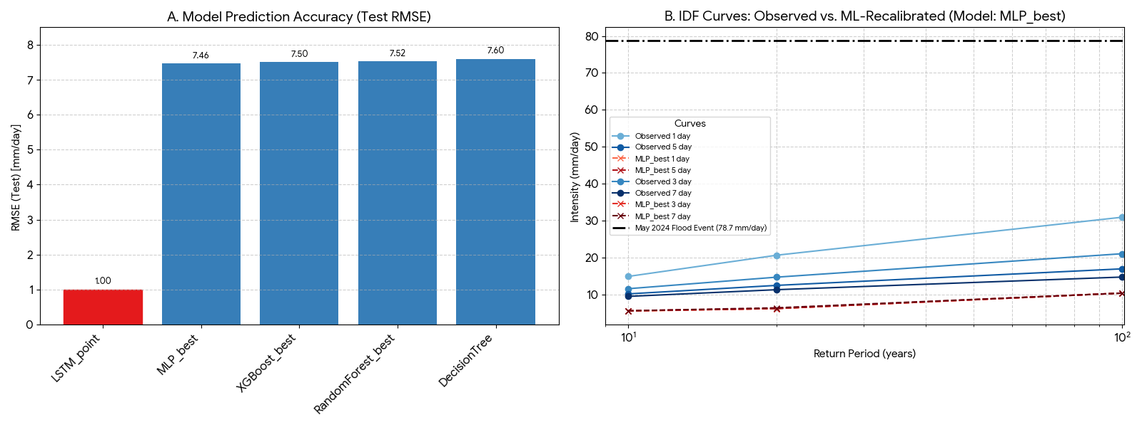
Can ML help us understand and recalibrate rainfall extremes?
Understanding:
Yes, partially.
LSTM and VAE highlight how much of the variability we can learn and where we systematically underestimate extremes.
Recalibrating IDF curves:
Not yet in this prototype.
ML-based IDF curves still underestimate the highest events, and May 2024 remains outside.
14 | Brazil Extreme Rainfall Intensity Forecaster
Notes:
So, can ML help us understand and recalibrate rainfall extremes?
From my results, I would say: for understanding, yes, partially.
The LSTM and VAE help reveal how much of the variability we can learn and clearly show where we underestimate extremes.
But for recalibrating IDF curves in a robust way, in this prototype the answer is not yet.
With 25 years of CHIRPS and relatively simple architectures, ML-based curves still underestimate the upper tail, and major events like May 2024 remain outside

Slide 17
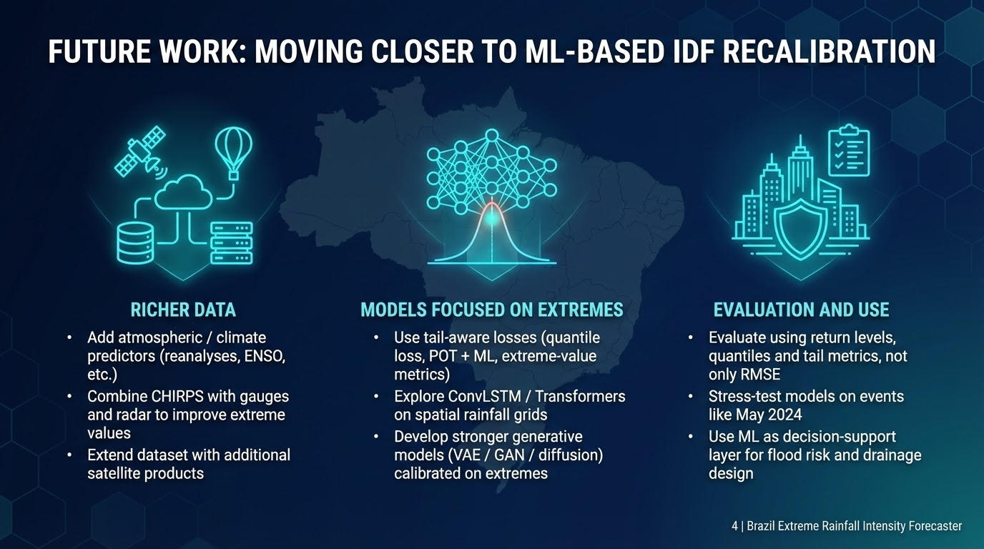
Notes:
To move closer to reliable ML-based IDF recalibration, I see three main directions.
First, richer data: adding atmospheric and climate predictors from reanalyses, combining CHIRPS with gauges and radar, and possibly extending the record with other satellite products.
Second, models and loss functions focused on extremes: tail-aware losses, peaks-over-threshold combined with ML, and architectures like ConvLSTM or Transformers on spatial grids.
Third, evaluation aligned with engineering use: using return levels, quantiles and tail metrics, and stress-testing models specifically on events like the 2024 floods.
With these components, ML can evolve from an exploratory tool to a more reliable support for IDF recalibration

Slide 18
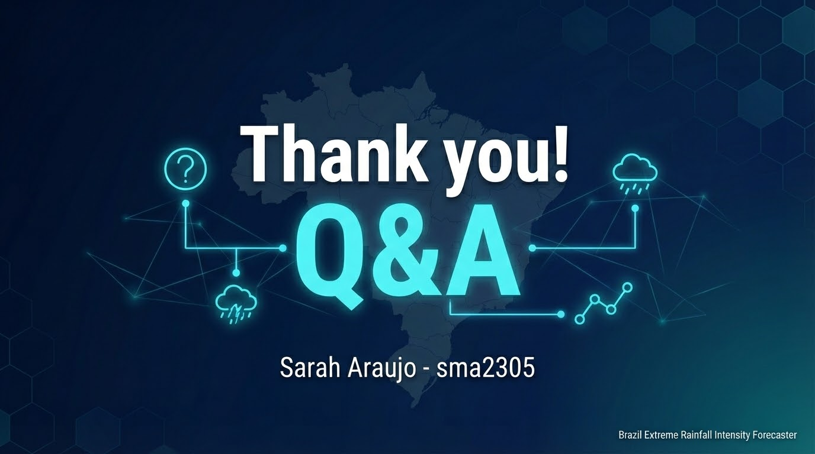
Notes:
thank you for you attention.

